Slide 1
Project Progress Review #3
(High Level / Low-Level Design)
Project Title: Detection of Events and Emerging Themes
from Social Media Streams
Project Guide: Mr. C. O. Prakash
Project Team: VAISHNAVI RAO (01FB15ECS334)
VARSHA R. (01FB15ECS337)
TEAM NAME: PES_334_337_000
TEAM ID: PW19COP01

Slide 2
Project Abstract and Scope
The micro-blogging platform, Twitter, has opened people up to an entirely new world of information-gathering and news-sharing, including but not limited to detailing everyday events and activities of the users, the “Tweeple”.
These Tweets are, for the most part, uncategorised and lack relevance because of this. Hashtags used and made up by the tweeple are the only forms of categorisation available right now.
Detecting events and trending topics from these hashtags in a way so as to make a user’s feed more enriching and optimal is the primary goal of this project.
A holistic comparison of the different methods in which to detect these events and trending topics is also included in the ambit of this project.

Slide 3
Design Approach
The design approach used in the project is a mix of both top-down and bottom-up, which, individually used, aren’t as effective as when used together.
Top-down design starts with a generalized model of system and keeps on defining the more specific part of it. When all components are composed the whole system comes into existence.
A top-down design is more suitable when the software solution needs to be designed from scratch and specific details are unknown. This approach is followed in the building of the project’s core, that is, the main model implementing the different algorithms.

Slide 4
Design Approach
The bottom up design model starts with most specific and basic components. It proceeds with composing higher level of components by using basic or lower level components. It keeps creating higher level components until the desired system is not evolved as one single component. With each higher level, the amount of abstraction is increased.
Bottom-up strategy is more suitable when a system needs to be created from some existing system, where the basic primitives can be used in the newer system. This approach is being followed to implement the front-end and the backend of the project.

Slide 5
Design Constraints, Assumptions & Dependencies
TECHNICAL CONSTRAINTS:
Programming Language: The programming language of choice for the bulk of the project is Python, given its immense popularity in non-enterprise-related applications. It offers an easier and faster way to build high-performing algorithms, along with an extensive collection of specialized libraries available as well.
Operating Systems and Platforms Supported: The vision is to build a fully-functional project that works smoothly across platforms, and are currently implementing the project on a standard Windows and linux device.
Frameworks: The front-end (user interface) is based on a standard MVC framework.

Slide 6
Design Constraints, Assumptions & Dependencies
DEPENDENCIES:
A major portion of the project design and implementation is dependent on the availability of data in large numbers, and subsequently, necessary servers to be able to stream data without any hindrance.

Slide 7
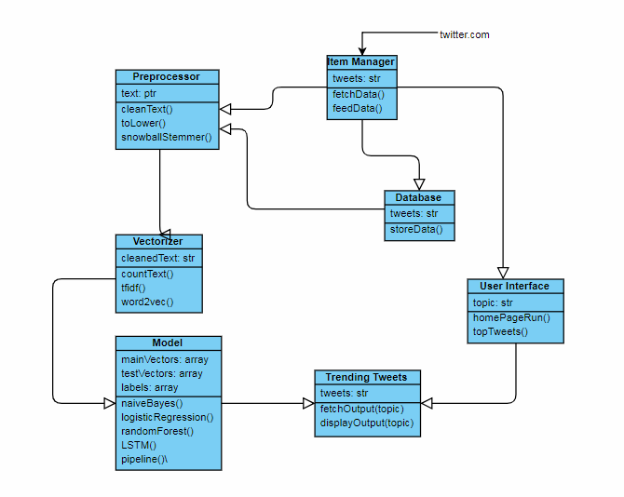
Design Description
MASTER CLASS DIAGRAM

Slide 8
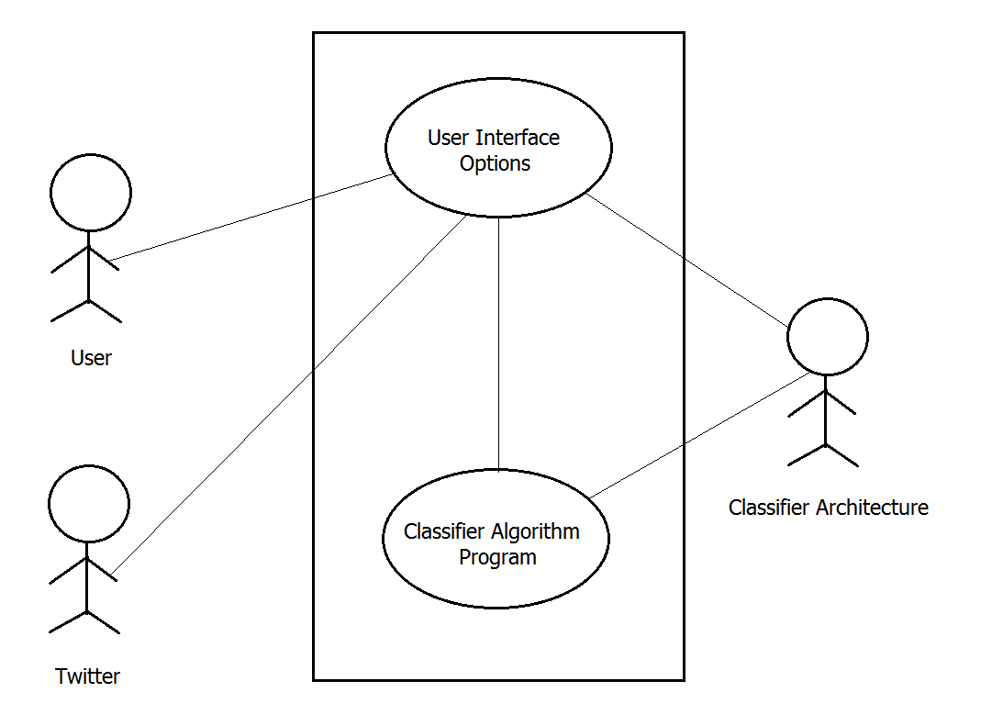
Design Description
USE CASE DIAGRAM

Slide 9
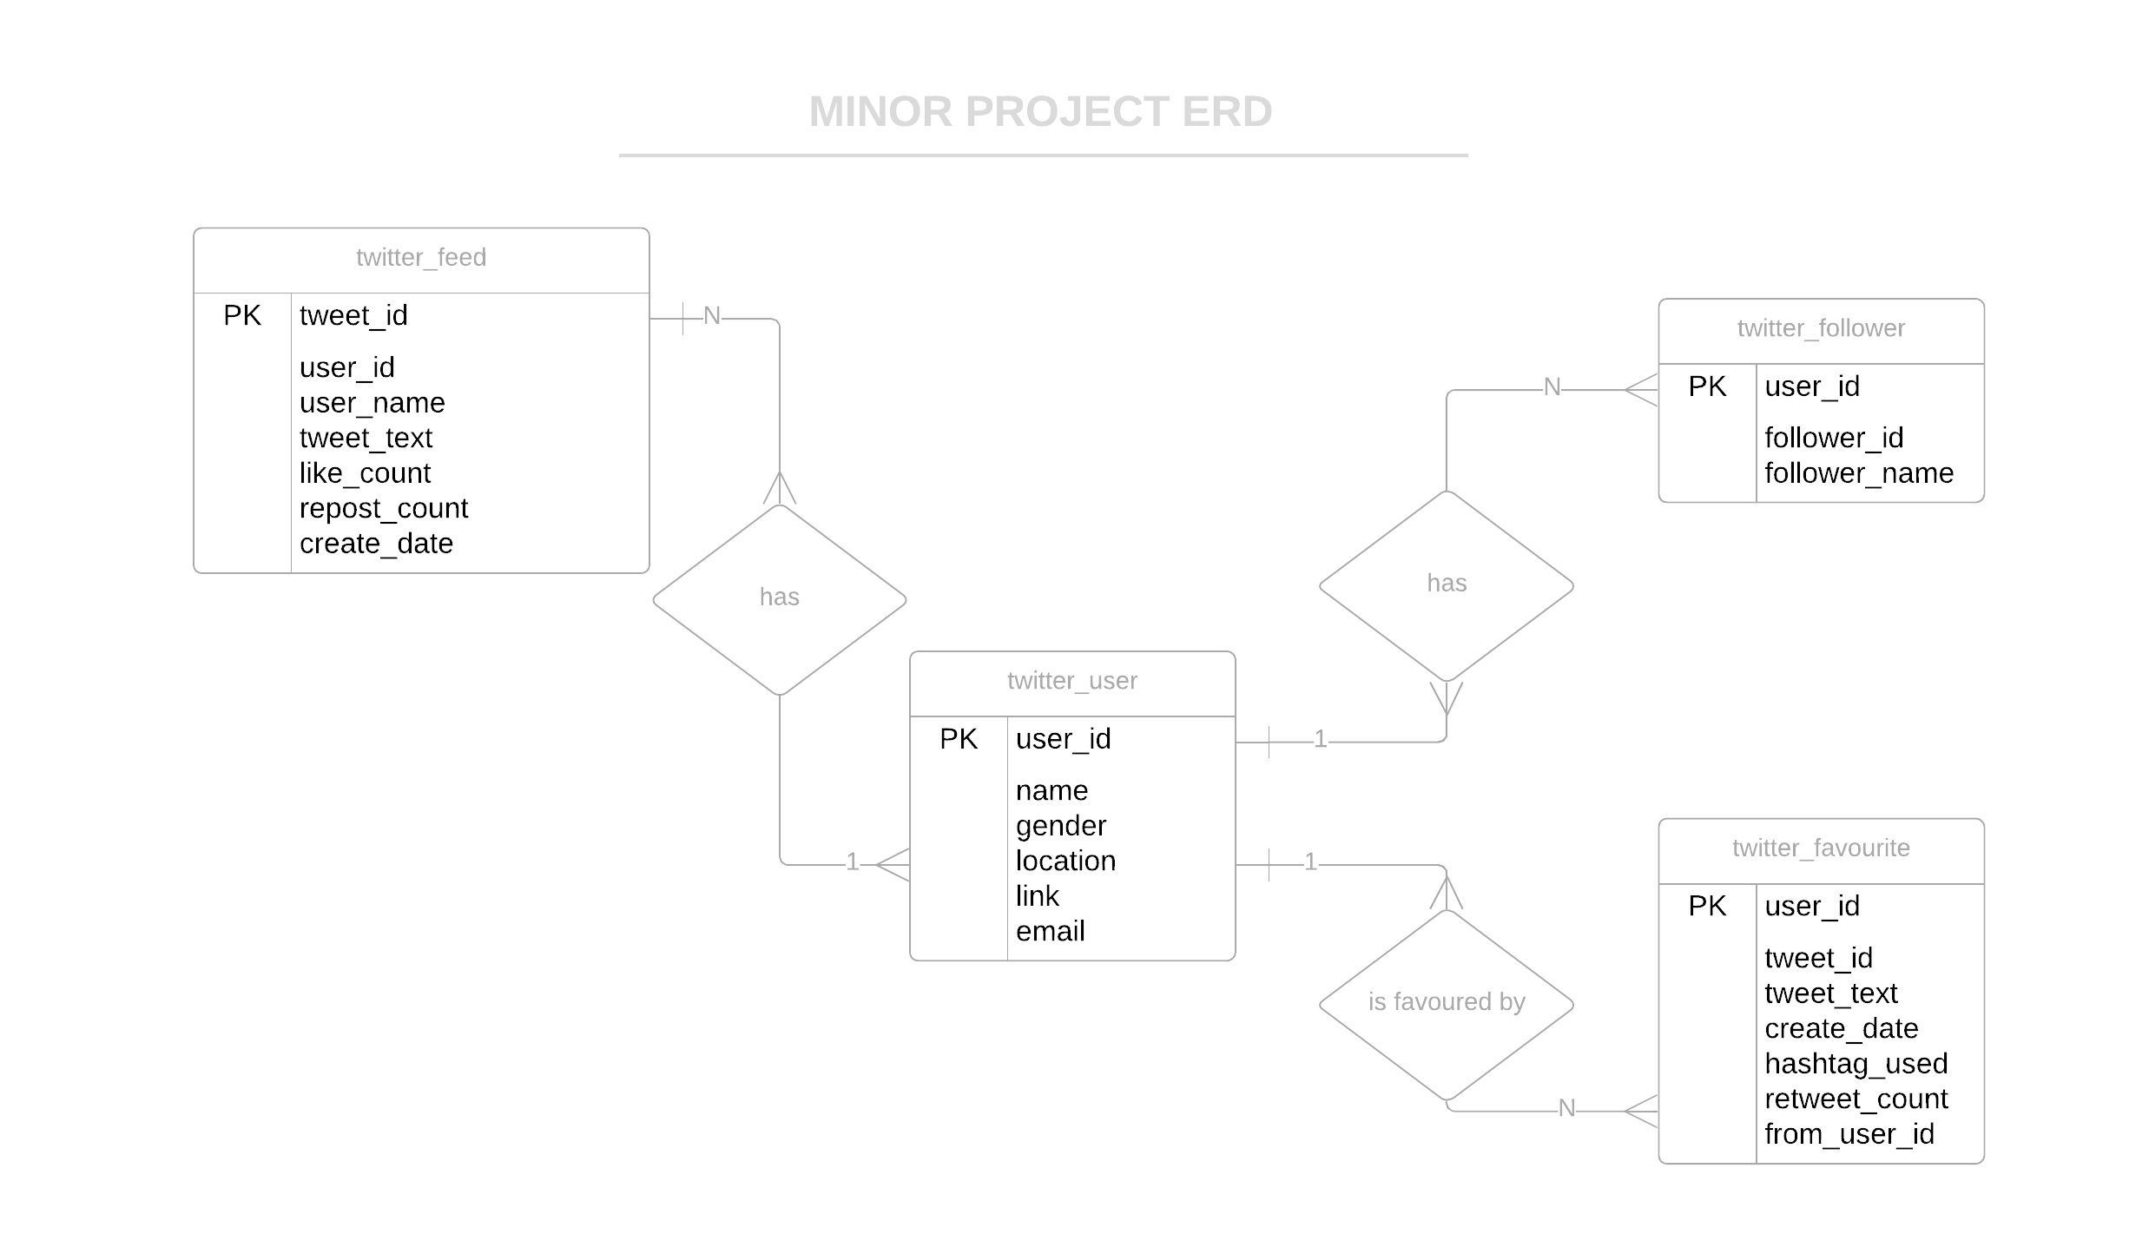
Design Description
ER DIAGRAM

Slide 10
Technologies Used
Python - An easy to use language with built-in modules for any operation. All backend operations can be carried out easily
Jupyter notebook - for implementing main algorithm and testing immediately on dataset.
Bootstrap - open source framework for front-end development. Simple and easy to use designs available. Front end will be only for display purposes with minimal functionality
Python modules like numpy, pandas, scikit-learn, keras and tensorflow to implement different algorithms for trending topic prediction.

Slide 11
Project Progress So far
The project has been completed 60%
The dataset has 4 labels currently. We have 10000+ tweets from different sources. We have fetched data separately for different scenarios.
Pakistan, Nepal, Chile, California Earthquakes for disaster tag (Label 1)
Ebola virus outbreak, H1N1 2009 outbreak and influenza outbreaks (Label 2)
Pulwama attacks, Peshawar attacks, uri attacks and mumbai attacks (Label 3)
Nepal floods, India floods, Hurricane Mexico, Philippines Typhoon and Cyclone Pam (Label 4)
Normal everyday tweets about randomly chosen topics to train our model for tweets not belonging to any category (Label 0)
But currently we’re still in the process of fetching data for label 3 (because of data scarcity)

Slide 12
Project Progress So far
The project has been completed 60%
The tweet dataset is fed into our model as a pandas dataframe.
Preprocessing is done to all the tweets :
Tweets are first converted to lower case
remove hash tags using BeautifulSoup
remove non-character such as digits and symbols
remove stop words such as "the" and "and"
convert to root words by stemming if needed
Tokenize the words

Slide 13
Project Progress So far
The project has been completed 60%
3. We then converted the cleaned tweets into vectors so as to feed into the algorithm. Count Vectorization, tfidf and Word2vec is performed and the tokens are stored as vectors
4. We ran our model on Multinomial Naive Bayes Classifier
5. We ran our model on Random Forest Classifier
6. We ran our model on Logistic Regression using Tfidf vectorization (better for Logistic)
We are yet to run our model on LSTM + RNN network

Slide 14
Project Progress So far
To do:
Add tweets from different sources for label 3 - terror attacks. The data mining is in progress.
Run the LSTM model on the dataset and get an accuracy. There were vectorization errors which need to be resolved.
The live tweets from twitter.com need to be fetched. Coding is in progress and stored in a database
The UI has progressed till home page section. Need to integrate backend with front end as a final deliverable

Slide 15
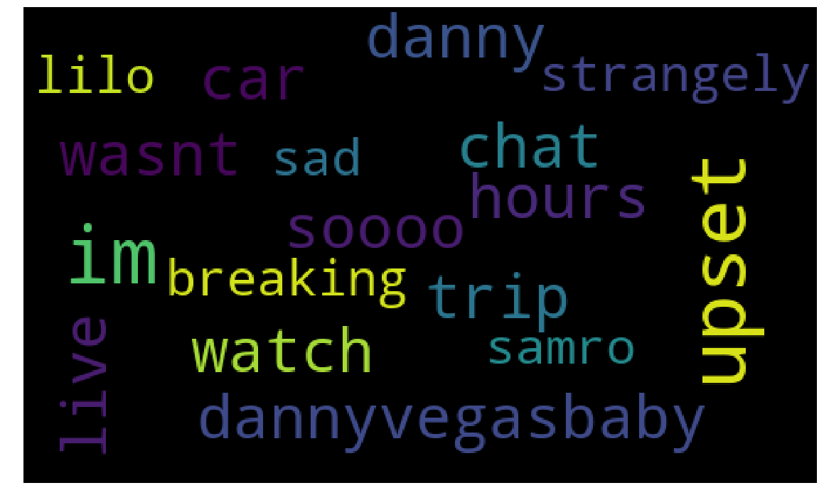
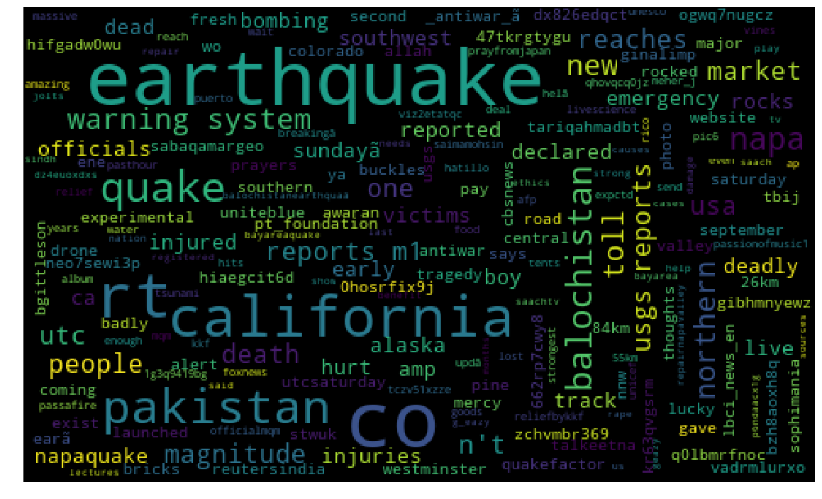
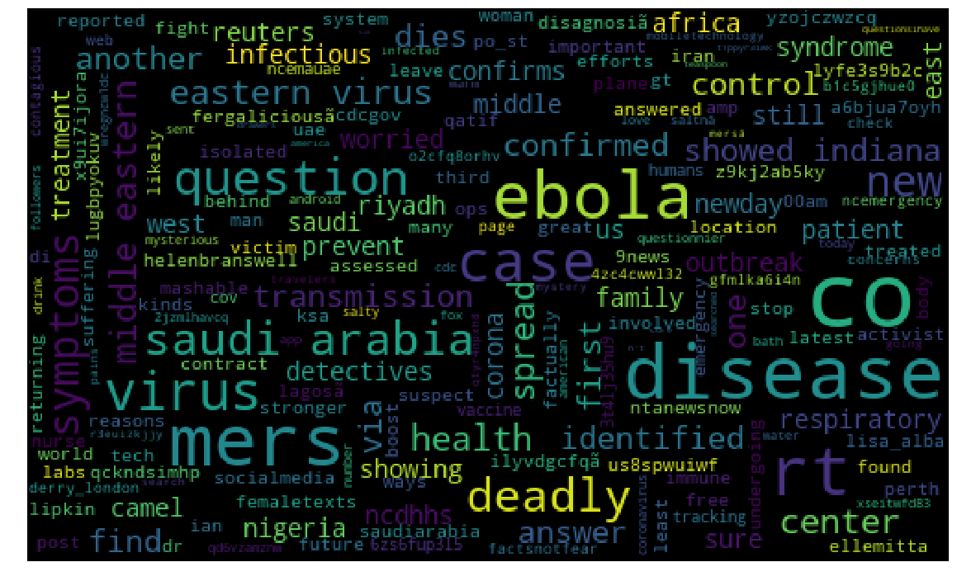
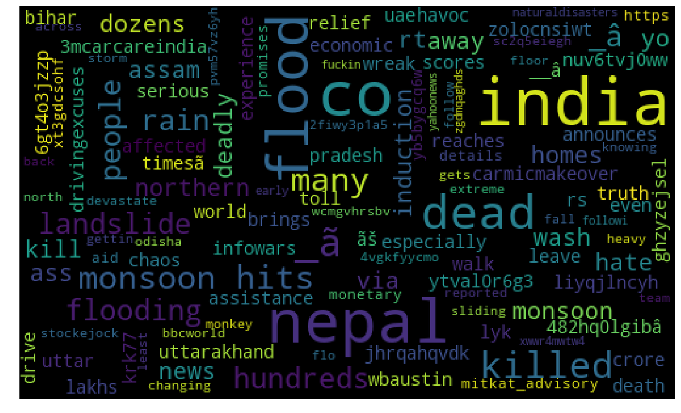
Project Demo

Slide 16
Project Demo
Dataset Description:
shape: (10564, 3)
Unnamed: 0 Tweets Category
0 0 USGS reports a M1.7 #earthquake 70km ESE of He... 1
1 1 QuakeFactor M 3.0, Southern Alaska: Sunday, Se... 1
RangeIndex: 10564 entries, 0 to 10563
Data columns (total 3 columns):
Unnamed: 0 Category
count 10564.000000 10564.000000
mean 5281.500000 1.903256
std 3049.708456 1.148911
min 0.000000 0.000000
25% 2640.750000 1.000000
50% 5281.500000 2.000000
75% 7922.250000 2.000000
max 10563.000000 4.000000
Loading 8451 training examples and 2113 validation examples.
After cleaning and preprocessing data,
napa looks like quake strong earthquake rocked northern california early sunday morning inj http co wr n bshu

Slide 17
1. Multinomial Naive Bayes:
With count vectorization
0.9408424041646948
Confusion Matrix :
[[ 52 18 15 14]
[ 0 784 0 1]
[ 2 2 819 2]
[ 19 29 23 333]]
2. Logistic regression:
With tfidf vectorization
0.9522006625650734
Confusion Matrix :
[[ 51 19 5 24]
[ 0 785 0 0]
[ 0 0 821 4]
[ 18 26 5 355]]
3. Random Forest classifier
With word2vec vectorization
0.9654519640321817
Confusion Matrix :
[[ 76 18 0 5]
[ 0 782 0 3]
[ 2 2 819 2]
[ 31 9 1 363]]

Slide 18
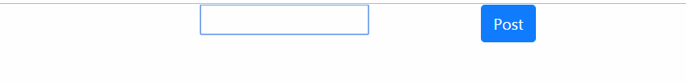
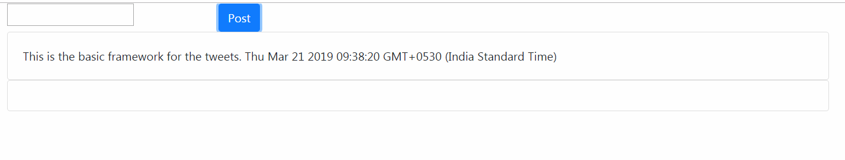
Project Demo

Slide 19
Thank You

